Slide 1
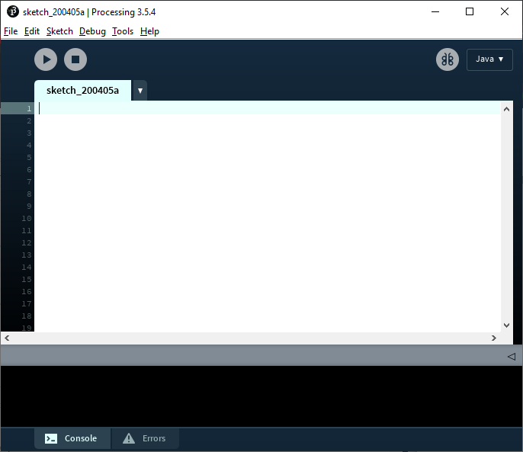
Language Selection
Run and Stop
Sketch Creation
Debugger Mode
Console Output

